Slide 1




ATEŞ KES TECHNOLOGY VENTURE
ExtinGard
100% domestic, biodegradable fire extinguishing powder from bio-waste.
The eco-friendly fire safety solution of the future.
TURKPATENT REGISTERED TRADEMARK
PATENT APPLICATION ALLOWED
Alp Kayra ERGUVAN · Ceyda Nur SÖYLEMEZ · Havva Yaren AYDIN
September 2026
Advisor: Gülçin SEZEN
Notes:
Opening: ExtinGard is a fully domestic, biodegradable fire extinguishing powder made from recycled eggshell and natural minerals. It holds a TURKPATENT registered trademark and an allowed patent application. In this presentation we will share our registration process, our technology, our test results and our go-to-market plan.

Slide 2

CONTENTS
Agenda
01
Registration and Intellectual Property
02
Problem and Solution
Trademark registration, patent decision, IP strategy
The fire crisis, the chemical threat, ExtinGard
03
Technology and Production
04
Testing and Validation
Triple suppression mechanism, production protocol
Seven material tests, Bursa Fire Department field work
05
Competition and Cost
06
Market and Business Model
Market comparison, unit cost analysis
TAM–SAM–SOM, B2G / B2B channels
07
Roadmap
08
Team and Contact
12-month plan, certification and pilot production
The Ateş Kes team and contact details
ExtinGard
02
Notes:
The presentation has eight main sections. Sections can be skipped to suit the audience: 05–06 for investors, 03–04 for corporate buyers, 01–04 for a competition jury.

Slide 3




INTELLECTUAL PROPERTY
Our Trademark Is Registered, Our Patent Is Allowed
The ExtinGard trademark has been registered and our patent application has been allowed.
TRADEMARK · REGISTERED
PATENT · DECISION TO GRANT ISSUED
ExtinGard
Fire Extinguishing Powder
Registration No
2026/001631
Application No
2025/021562
Registration Date
04.06.2026
Filing Date
24.12.2025
Nice Classes
01 · 09 · 35
IPC Class
A62D 1/00
Protection Period
06.01.2026 – 06.01.2036
Decision
25.08.2026 · Patent to be granted
Rights holders
Next step
Gülçin Sezen · Alp Kayra Erguvan · Ceyda Nur Söylemez · Havva Yaren Aydın
PCT international application — EU (EPO) and Gulf markets
ExtinGard
03
Notes:
This slide carries the freshest news in the deck. The trademark registration protects the ExtinGard name in Nice classes 01, 09 and 35; the patent protects the invention 'Fire Extinguishing Powder Composed of Natural Components'. The TURKPATENT examination report found all 11 claims positive on novelty, inventive step and industrial applicability. Note: once the decision to grant is published in the bulletin, a six-month third-party opposition period runs; the decision becomes final at the end of it. The jury may note the numbers down, so keep printed copies of the certificates with you.

Slide 4




PROBLEM
The Fire Crisis Is Growing — Existing Solutions Pollute
%30
$328 B
80,000 ha
Increase in global fire frequency
Annual global economic loss
Forest burned per year in Türkiye
IPCC, 2023
Fire disasters
Average
Conventional extinguishants suppress the fire but leave secondary damage behind:
ABC Powder (MAP)
CO₂ Extinguishers
Halogenated Extinguishers
Import Dependence
Damages metal surfaces, degrades soil structure and contaminates water sources.
Reduces oxygen concentration to dangerous levels in enclosed spaces.
Damages the ozone layer; restricted under the Montreal Protocol.
Imported raw material makes large-scale disaster response expensive.
ExtinGard
04
Notes:
The problem has two layers: fires are increasing, and the extinguishants in use create serious environmental and health costs of their own. Sources: IPCC 2023; Kırtaş & Altundağ 2023; Lee et al. 2021; EPA 2019.

Slide 5
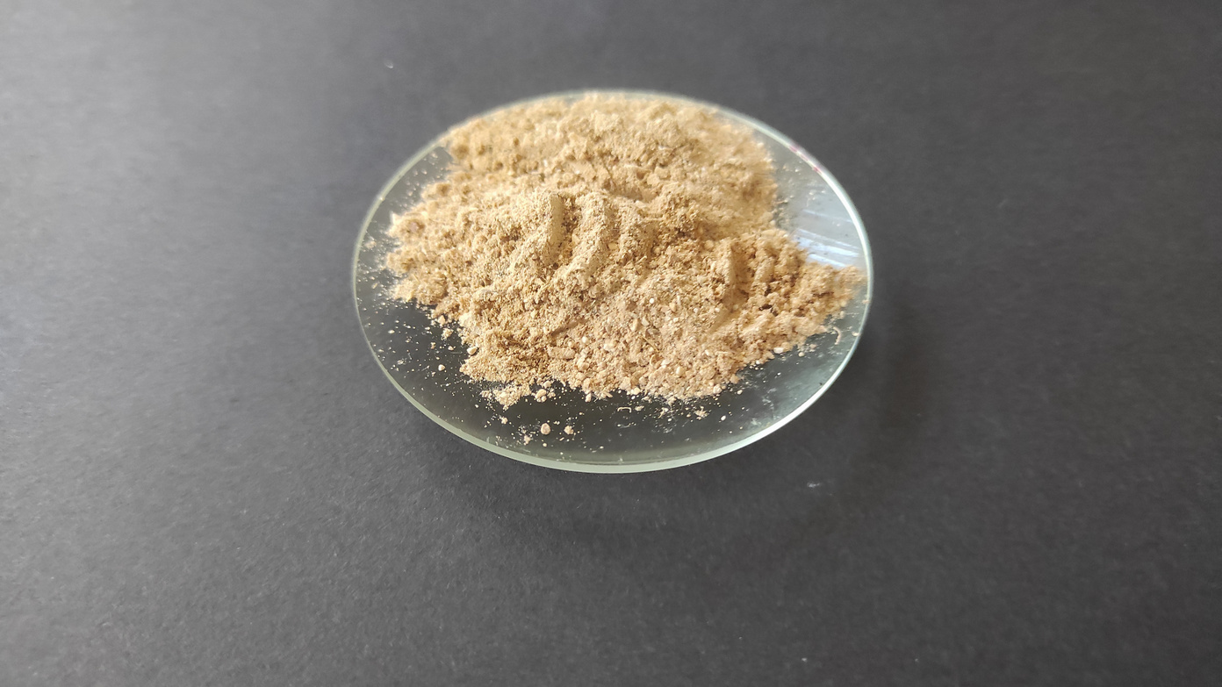


SOLUTION
ExtinGard
A next-generation, fully natural extinguishing powder that attacks all three corners of the fire triangle at once.
50% Bio-waste, 100% Natural
Made from recycled eggshell and natural minerals. Releases no toxic gas and contains no PFAS.
A · B · C · F Full Coverage
Effective on solid, liquid, gas and cooking-oil fires. The widest class profile on the market.
Cost Leadership
Unit cost of 0.0497 TL/g — 5–6× cheaper than ABC powder and 3× cheaper than BC powder.
ExtinGard powder — laboratory production
05
Notes:
ExtinGard's three core value propositions: natural content, broad fire-class coverage and cost leadership. No other product on the market offers all three at once.

Slide 6



TECHNOLOGY
Triple Suppression Mechanism
The patented composition absorbs heat · releases water vapour · dilutes oxygen — all at the same time.
350 °C
512 °C
840 °C
~200 °C
Thermal Absorption
Second Heat Wave
Oxygen Dilution
Mineral Blanket
Mg(OH)₂ · 20%
Ca(OH)₂ · 10%
Eggshell · 50%
Al(OH)₃ + Kaolin · 18%
Decomposes endothermically; absorbs heat, cools the environment and releases water vapour.
Activates at a higher temperature and sustains the cooling effect.
CaCO₃ decomposes; the released CO₂ lowers ambient oxygen and smothers the flame.
Releases water vapour and forms a heat-resistant blanket layer on the surface.
PATENTED COMPOSITION
50% eggshell · 20% Mg(OH)₂ · 10% Ca(OH)₂ · 10% Al(OH)₃ · 8% kaolin · 2% magnesium stearate
The TURKPATENT examination report assessed all 11 claims positively for novelty, inventive step and industrial applicability.
ExtinGard
06
Notes:
The technical-depth slide, taken directly from the patent claims. Mg(OH)₂ and Ca(OH)₂ absorb heat through endothermic decomposition and release water vapour; the CaCO₃ in the eggshell releases CO₂ at 840 °C and dilutes oxygen; Al(OH)₃ and kaolin form a heat-resistant mineral blanket on the surface. Magnesium stearate prevents caking and keeps the powder free-flowing. The composition was published with the patent application, so there is no issue in sharing it.

Slide 7
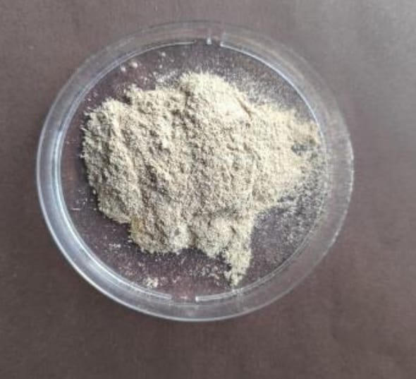
PRODUCTION
The Production Protocol in Four Steps
01
Eggshell cleaning
Recycled shells are separated from their membranes and cleaned.
02
Drying
The cleaned shells are dried under controlled moisture content.
03
Milling
The dried shells are milled together with kaolin into a fine powder.
04
Mixing and sieving
Mg(OH)₂, Ca(OH)₂, Al(OH)₃ and magnesium stearate are added at the specified ratios and sieved until homogeneous.
ExtinGard powder produced to the protocol
100% domestic raw material — the supply chain is entirely within Türkiye.
ExtinGard
07
Notes:
The production protocol is standardised exactly as defined in the patent claim and is reproducible. The next step is a pilot production line — scaling the milling and sieving steps to industrial capacity.

Slide 8

VALIDATION
Test Results: 7 Materials, 7 Successes
Combustible Material | Class | Result | Key Observation
Paper / Cardboard | A | ✓ Successful | Flame spread stopped immediately
Cotton | A | ✓ Successful | Rapid extinction observed
Polyester Fabric | A | ✓ Successful | Effective suppression despite the synthetic structure
Paint Thinner | B | ✓ Successful | Surface filming suppressed the flame in ~5 s
Petrol | B | ✓ Successful | Spread across the liquid surface was prevented; extinguished in 6–8 s
LPG | C | ✓ Successful | Gas flame cut off in 3–4 s
Cooking Oil | F | ✓ Successful | The oil surface was cooled and isolated; complete extinction
The tests were carried out with our own means and jointly with the Bursa Fire Department. TS EN 615 certification testing has not yet been completed — the certification application is on our roadmap.
ExtinGard
08
Notes:
Controlled suppression tests were run on seven different combustible materials; all were successful. Most of the tests were captured on video. The transparency note matters: certification testing has not been done yet, and we say so openly.

Slide 9
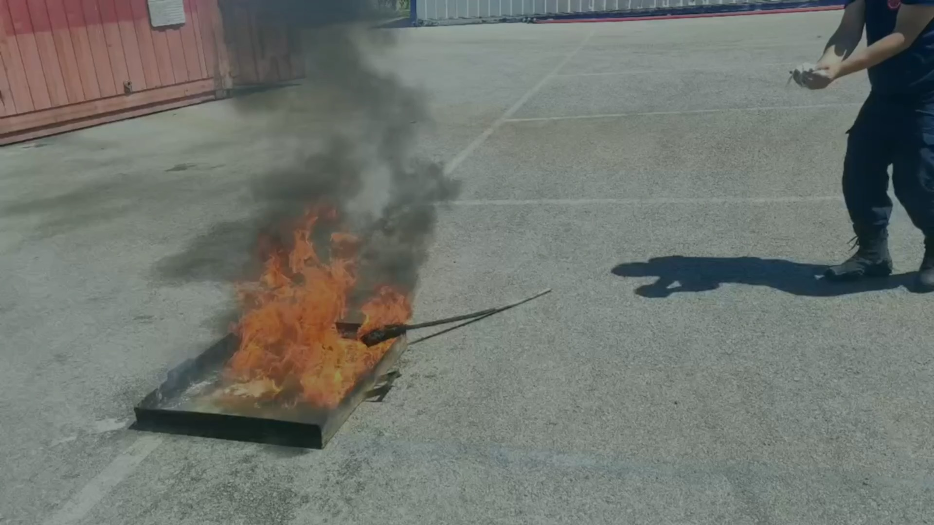

FIELD VALIDATION
Tested in the Field, Together With the Fire Department
Joint field tests were conducted with the Bursa Fire Department Search, Rescue and Response Units.
Letter-of-intent talks have begun for the use of the training ground.
Most of the tests were recorded on video as evidence of reproducibility.
The business model and IP strategy were reviewed at the T3 Entrepreneurship Centre DENEYAP Entrepreneurship Programme.
Field test parameters: extinguishing time · flame spread rate · CO₂ release · safety impact
ExtinGard
09
Notes:
Field validation is the step that moves us from a student project to a commercialisable product. The relationship built with the Bursa Fire Department means both technical feedback and, in time, a reference customer.

Slide 10
COMPETITION
Comparison With Market Products
Attribute | ExtinGard | BC Powder (NaHCO₃) | ABC Powder (MAP)
Fire class effectiveness | A, B, C and F — the widest coverage | B and C only | A, B, C — ineffective on class F
Unit cost | 0.0497 TL/g | 0.12 – 0.15 TL/g (≈3× more expensive) | 0.25 – 0.30 TL/g (≈5–6× more expensive)
Environmental impact | Biodegradable, leaves no residue | Leaves harmful residue | Residue harmful to soil and water
Human health | Releases no toxic gas | Irritant to the respiratory tract and skin | Irritant to the respiratory tract and skin
Coverage | Domestic + industrial | Limited use | Broad, but ineffective on class F
Domestic content | 100% domestic raw material | Import-dependent | Import-dependent
ExtinGard is the only option that leads on three axes at once: coverage, cost and environmental impact.
ExtinGard
10
Notes:
Competitors can be good on one axis; ExtinGard is good on all three. The fact that ABC powder is ineffective on class F (cooking oil) fires is a critical point of differentiation for us.

Slide 11



ECONOMICS
A Clear Leader on Unit Cost
≈ 225,000 TL
Annual saving against ABC powder at 1 tonne/year usage (82%)
5 – 6×
Unit cost advantage over ABC powder; 3× over BC powder
%100
Domestic, bio-waste-derived raw material — no currency risk
ExtinGard
11
Notes:
The cost advantage is not just about price, it is about accessibility. Large-scale stockpiling becomes economical for public institutions and municipalities. On the unit costs shown in the chart, the gap is roughly 10-fold against CO₂ extinguishers and roughly 20-fold against halon.

Slide 12



MARKET
A Growing Market, at the Right Time
PFAS restrictions and the climate-driven rise in fires are creating a “blue ocean” for eco-friendly extinguishants.
TAM
SAM
SOM
$5.02 B
$60.3 M
$0.30 M
Global PFAS-free fire extinguishant segment
Addressable market in Türkiye
Year-1 target market share
$33.5 B
%18
%30
2023+
Global fire extinguishing market (2024)
Annual growth of the PFAS-free segment
Increase in global fire frequency
EU PFAS restriction directives in force
ExtinGard
12
Notes:
Market timing is in our favour: the EU's PFAS restrictions are forcing incumbents to reformulate, while we were PFAS-free from the start.

Slide 13




BUSINESS MODEL
A Three-Channel Go-to-Market
PRIORITY 1
PRIORITY 2
LONG TERM
B2G
B2B
B2C
Public Procurement
Corporate Sales
Consumer Kit
The General Directorate of Forestry, AFAD and municipalities. High-volume, recurring procurement; our first priority channel.
Industrial plants, logistics hubs and power stations. Refill agreements and annual contracts.
Home and vehicle mini extinguisher kits. A long-term, brand-awareness channel.
A staged strategy: first a public safety reference, then industrial facilities, finally consumer kits. Each stage builds the credibility base for the next.
ExtinGard
13
Notes:
B2G is our priority because a public reference brings both volume and credibility. The Bursa Fire Department relationship opens that door.

Slide 14




TARGET AUDIENCE
Who Do We Sell To?
Target Institutions
User Profiles
Public institutions
Facility managers
Fire departments, municipalities, AFAD, the General Directorate of Forestry
Decision-makers responsible for fire safety investment
Industrial plants
Procurement officers
Manufacturing plants, chemical and food factories
Units that source safety equipment
Logistics hubs
Occupational safety specialists
Warehouses, bonded stores and distribution centres
EHS (Environment–Health–Safety) personnel
Power stations
Fire safety experts
Generation and distribution facilities, battery stores
Fire crews and fire safety consultants
ExtinGard
14
Notes:
The person who makes the purchase decision and the person who uses the product are usually different. We frame the message for each separately: cost and compliance for the decision-maker, safety and performance for the user.

Slide 15
PLAN
12-Month Roadmap
Q1
Q2
Q3
Q4
Jun – Sep 2026
Sep – Dec 2026
Jan – Mar 2027
Mar – Jun 2027
Field tests
Certification
Pilot production
Investment and export
Controlled tests at the Bursa Fire Department training ground
Application process for the TS EN 615 standard
Setting up the pilot production line
Investment round and export strategy
OUTPUT
OUTPUT
OUTPUT
OUTPUT
Quantitative suppression data and a technical report
International standard compliance certificate
First B2B sales contracts
Seed capital + SME grant application
Long term: PCT international patent expansion — priority markets are the EU (EPO), Türkiye and the Gulf states.
ExtinGard
15
Notes:
The roadmap is certification-driven: without the TS EN 615 certificate we cannot enter public tenders. That makes Q2 the most critical quarter.

Slide 16



CREDENTIALS
Achievements and Institutional Relationships
T3 Entrepreneurship Centre – DENEYAP Entrepreneurship Programme
Participation in the training camp; business model and IP strategy review received.
Bursa Fire Department Search, Rescue and Response Units
2nd place
Joint field tests and professional technical assessment meetings.
Üsküdar University
10th Science and Ideas Festival
BTSO Kamil Tolon Science and Art Centre
The R&D environment and laboratory infrastructure where the product was developed.
Second prize in the health category — independent jury confirmation of ExtinGard's scientific validity.
Turkish Patent and Trademark Office
The ExtinGard trademark and the extinguishing formulation are protected.
ExtinGard
16
Notes:
This is the credibility slide. It carries three different kinds of validation: academic (Üsküdar), entrepreneurial (T3) and operational (Bursa Fire Department).

Slide 17
TEAM
The Ateş Kes Team
A three-student team with DENEYAP, BİLSEM and T3 Entrepreneurship Centre backgrounds, plus a project advisor.
AE
CS
HA
GS
Alp Kayra Erguvan
Ceyda Nur Söylemez
Havva Yaren Aydın
Gülçin Sezen
R&D
Analyst
Strategist
Advisor
Formulation development, test protocols and the production process.
Market research, competitive analysis and cost modelling.
Business model, institutional relationships and go-to-market strategy.
Project advisory, scientific guidance and institutional processes.
MISSION
VISION
To reduce chemical dependence in firefighting and to lead with sustainable solutions that harm neither nature nor human health.
To turn a green technology brand born in Türkiye into a worldwide standard through affordable products.
ExtinGard
17
Notes:
Team introduction. Three students with three clear areas of responsibility — R&D, analysis and strategy — alongside project advisor Gülçin Sezen. The common thread: the technical grounding of DENEYAP and BİLSEM.

Slide 18




Thank You
Any questions? Get in touch with us.
E-mail
Phone
extingard@gmail.com
0542 245 24 46
Instagram
LinkedIn
@extingard
ExtinGard
ExtinGard · TURKPATENT registered trademark (2026/001631) and allowed patent application (2025/021562)
Notes:
Closing. Move into the Q&A from here.

